Slide 1

My step tracker project
©Moonpreneur Inc. 2019

Slide 2
Introduction
My name is Praise. I am 11 and I have been a part of Moonpreneur. My project is called the step tracker.
The step tracker is a digital tool or device that counts the number of steps a person takes. It is used to measure physical activity, motivate individuals to move more, and assess fitness levels.
©Moonpreneur Inc. 2019

Slide 3
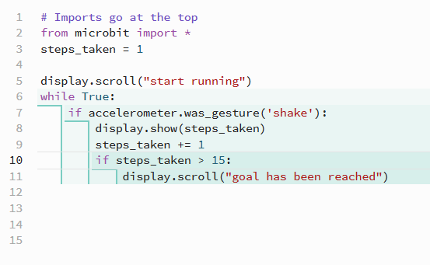
Show and tell topic
My step tracker will count the amount of steps you take. For this project I set the goal at 10 (but you can change it to something else if you want) and when the goal is met it will display “goal has been met”, play a song, and show a stickman dancing. This means you have reached the amount of steps you want and you are done
©Moonpreneur Inc. 2019

Slide 4
Project highlights
I like this project because it can help to motivate you to stay healthy and fit.
©Moonpreneur Inc. 2019

Slide 5
Thank You!
©Moonpreneur Inc. 2019

